Slide 1

Sheikh Hasina National Institute
of
Youth Development
ICT-101/WEB-101
ICT Fundamentals & PC Computing
for
Diploma in ICT
Lecture File: 02
History and Historical Evolution of Computers
Prepared by:
Professor K M Akkas Ali
akkas@juniv.edu, akkas_khan@yahoo.com
Institute of Information Technology (IIT)
Jahangirnagar University, Dhaka-1342

Slide 2
Lecture File-02:
History and Historical Evolution of Computers
Topics to be Discussed
History: Counting Devices Before the Advent of Computers
 | The Abacus: First Counting Device
 | Napier’s Bones
 | Slide Rule
 | Stepped Reckoner
 | Difference Engine & Analytical Engine
 | Census Tabulator
Historical Evolution of Computers
 | Mark-I: First Digital Computer
 | ABC: First Automatic Electronic Digital Computer
 | ENIAC: First Electronic Computer
 | EDSAC: First Stored Program Electronic Computer
 | UNIVAC: First Commercially Produced Computer

Slide 3
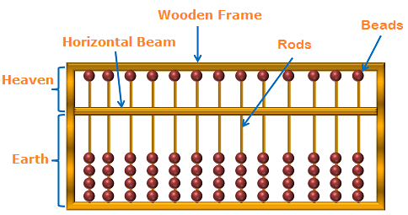
Counting Devices before the advent of Computers
The Abacus: First Counting Device
Abacus is a wooden frame with balls or beads strung on parallel rods fixed in the frame which is divided by a horizontal beam into two regions-
Upper region of the beam is known as “heaven”.
Lower region is termed as “earth”.
Origin: Between 5000 and 2000 B.C. in China and was used by Greek, Roman, Japanese and Chinese in pre-Christian times.
Figure-1 below shows the simplified diagram of an abacus.
Two fundamental concepts were associated with the abacus:
Numerical information can be represented in a physical form.
This information can be manipulated in the physical form to produce the required result.
Figure-1: The Abacus

Slide 4
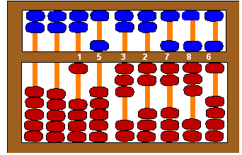
Counting Devices before the advent of Computers
The Abacus: First Counting Device…
Representing Numerical Values Using Abacus:
In the Chinese Abacus, there are 2 beads on each wire in the heaven and 5 beads on each wire in the earth.
A bead in heaven was considered to have a power (value) of 5 and the bead on earth a power (value) of 1.
Calculations were performed by moving beads away from towards the beam; the rule being that a bead has a numerical value only when it is adjacent to the beam.
Figure-2 shows a Chinese abacus representing the number 001532786.
Note:
It may be easily seen from the figure that two of the beads of the Chinese abacus are redundant.
Figure-2: Chinese Abacus

Slide 5
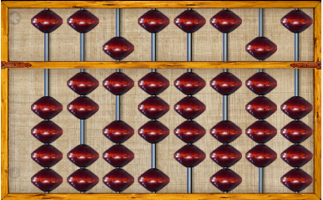
Counting Devices before the advent of Computers
The Abacus: First Counting Device…
Soroban: Japanese version of the Abacus:
In 1530, the two extra beads of the Chinese abacus were eliminated and adopted in the Japanese version of abacus called “Soroban”, i.e. one bead in the heaven and four beads in the earth.
Figure-3 shows a Japanese abacus representing the number 02634190.
Figure-3: Soroban- the Japanese version of abacus

Slide 6
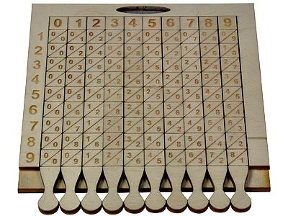
Counting Devices before the advent of Computers
Napier’s Bones
Napier's bones, also called Napier's rods, is a manually-operated calculating device which was used to perform multiplication, division, square root etc. using logarithmic rules.
It was invented by John Napier, a mathematician from Scotland.
The rods used in the device were carved from bones of dead animals.
These rods have numbers marked on them in such a way that by simply placing them side by side, products and quotients of large numbers can be obtained.
Note:
Rules of logarithm was at first invented by John Napier.
Figure-4: The Napier’s Bones

Slide 7
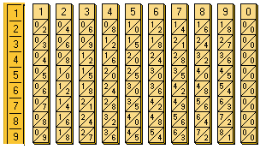
Counting Devices before the advent of Computers
Napier’s Bones…
A set consists of 10 rods corresponding to digits 0 to 9, and a special eleventh rod that is used to represent the multiplier.
Surface of each rod comprises 9 squares, and each square, except for the top one, comprises two halves divided by a diagonal line.
The first square of each rod holds a single digit, and the other squares hold this number's double, triple, quadruple, quintuple, and so on.
The digits of each product are written one to each side of the diagonal; numbers less than 10 occupy the lower triangle, with a zero in the top half.
6
Figure-5: Set of Rods
Slide-7

Slide 8
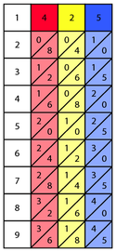
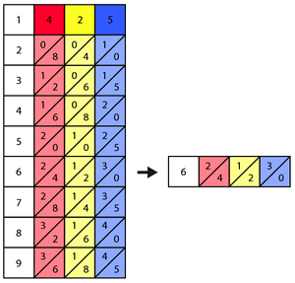

Counting Devices before the advent of Computers
Napier’s Bones…
Illustrating Napier's Bones for multiplication:
Problem-1: Multiply 425 by 6 (425 x 6 = ?)
Solution:
At first, place the bones (rods) corresponding to the leading number of the problem side by side. In this example, the bones 4, 2, and 5 are placed in the correct order as shown below. The rod that represents the multiplier is placed at the left-most of the other rods.
Looking at the first column, choose the number wishing to multiply by. In this example, that number is 6. The row this number is located in is the only row needed to perform the remaining calculations and thus the rest of the board is cleared below to allow more clarity in the remaining steps.
Starting at the right side of the row, evaluate the
diagonal columns by adding the numbers that share the same diagonal column. Single numbers simply remain that number. Now read the results of the summations from left to right produces the final answer of 2550.

Slide 9
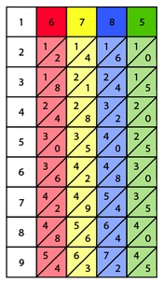
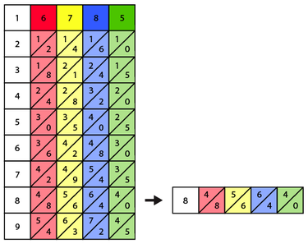
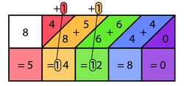
Counting Devices before the advent of Computers
Napier’s Bones…
Illustrating Napier's Bones for multiplication:
Problem-2: Multiply 6785 by 8 (6785 x 8 = ?)
Solution:
In this example, the bones 6, 7, 8 and 5 are placed in the correct order as shown here. The rod that represents the multiplier is placed at the left-most of the other rods.
Here, the multiplier is 8.
Starting at the right side of the row, evaluate each diagonal column. If the sum of a diagonal column equals 10 or greater the tens, place of this sum must be carried over and added
along with the numbers in the diagonal column to the immediate left as demonstrated below.
After each diagonal column has been evaluated, the calculated numbers can be read from left to right to produce a final answer which is 54280.

Slide 10
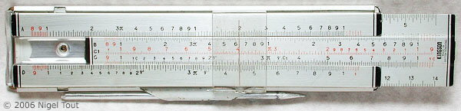
Counting Devices before the advent of Computers
Slide Rule
This is a mechanical calculating device based on the principles of logarithms.
It was invented by an English Mathematician named William Oughtred.
This device was used to calculate multiplication, division, square root etc. using logarithm very quickly as that compared to Napier’s Bone.
Before electronic calculators were developed, slide rules were the tool used most often in science and engineering.
Figure-6: A Slide Rule
A slide rule consists of three parts: body, slide and cursor.
The body and the slide are marked with logarithmic scales.
The scales (A-D) are labeled on the left-hand side of the slide rule. (Multiplication and division are performed using the C and D scales. Square and square root are performed with the A and B scales).
The cursor has a hairline that facilitates accurate positioning of the cursor at a specific point on some scale.

Slide 11
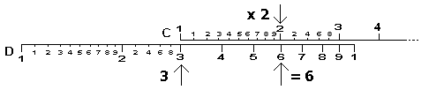
Counting Devices before the advent of Computers
Slide Rule…
Illustrating Slide Rule for multiplication:
Problem: Multiply 3 by 2 (3 x 2 = ?)
Solution:
Move the sliding middle section with scale "C" so that the 1 on the scale matches the 3 on the lower fixed section with scale "D".
Now read along the top scale to the 2 and see what it says on the bottom scale.
The bottom scale should read approximately 6 which is the answer.
Figure-7: Calculating 3 x 2 on a Slide Rule
Notes:
Basic Multiplication using Slide Rule:
The most basic procedure carried out on a slide rule is the multiplication of two numbers u and v using the C and D scales. These two scales are identical. C is on the slide, and D is on the body.
Move the hairline over u on the D scale.
Move the slide so that its beginning (marked by 1 on the C scale, and also called the index of the C scale) lines up with the hairline.
Move the hairline to the number v on the C scale.
Read the result underneath the hairline on the D scale.
If the number v projects beyond the end of the slide rule, move the end of the slide rule (marked with 10 on the C scale) above u and read the result as before on the D scale underneath the number v on the C scale.

Slide 12
Counting Devices before the advent of Computers
Stepped Reckoner
Stepped Reckoner was a digital mechanical calculator invented by German mathematician Gottfried Leibniz in 1671.
This is the first calculator which was able to perform multiplication, division, addition, subtraction, and square root.
Leibniz was the first man who started the usage of binary system.

Slide 13
Counting Devices before the advent of Computers
Difference Engine & Analytical Engine
Difference Engine:
The Difference Engine is an automatic mechanical calculator which was developed by the English mathematician Charles Babbage in 1820s.
This device was used to perform simple mathematical computations needed for setting up trigonometric and logarithmic tables without any error.
Analytical Engine:
The Analytical Engine, developed in 1842 by Charles Babbage, was a prototype computer. This machine had a punched card input, a memory unit, an arithmetic unit and an automatic printout.
It was to be capable of performing the basic arithmetic functions for any mathematical problem, and it was to do so at an average speed of 60 additions per minute.

Slide 14
Counting Devices before the advent of Computers
Difference Engine & Analytical Engine…
Charles Babbage: The Father of Modern Computer
Charles Babbage was a nineteenth century Professor of Mathematics at Cambridge University.
He is considered the father of modern digital computers though his work did not directly influence the design of the first modern computer.
His efforts established a number of principles, which have been shown to be fundamental to the design of any digital computer.
Babbage was unable to produce a working model of Analytical Engine
because of financial difficulties as well as technological constraints (i.e. unavailable of the materials needed to manufacture the machine).

Slide 15
Ada: The First Programming Language
Ada is the name of first programming language of the world which was developed by Augusta Ada Byron, the daughter of famous British poet Lord Byron.
She is called the first programmer of the world.
She found out some errors on Babbage’s works and also wrote some programs for Babbage’s Analytical Engine.

Slide 16
Logic Circuit Simplification by Boolean Algebra
After Babbage’s work on computers (1871), little progress was made until 1937. An important theoretical development occurred between 1847 and 1854.
George Boole, an English Mathematician, developed an algebraic system called Boolean Algebra.
Boolean Algebra is used widely today for representing and manipulating logical expressions and for the simplification of logic gates.

Slide 17
Counting Devices before the advent of Computers
Census Tabulator
Census Tabulator is a device developed by Herman Hollerith which was used to tally the results of the 1890 US census. This was the first wholly successful information processing system to replace pen and paper.
Hand-counting results of 1880 census was proving impractical— it was laborious and error-prone operation that took a full 7 years to tabulate.
Census Tabulator reduced a ten-year job to three months, saved the 1890 taxpayers five million dollars, and earned him an 1890 Columbia PhD.
Herman Hollerith at first introduced the concept of punched cards, which were extensively used as input medium in computers even in late 1970s.

Slide 18
Historical Evolution of Computers
Mark-I: First Digital Computer
Mark-I was the first fully automatic calculating machine which was designed by Howard A. Aiken of Harvard University, in collaboration with IBM (International Business Machines) Corporation in 1937.
It was an electro-mechanical device, since both mechanical and electronic components were used in its design.
It measured 15 m long, 2.4 m high, and 0.6 m wide.
The input and output were performed by punched cards and paper tapes.
It could automatically perform a sequence of arithmetic operations.
Mark-I was capable of performing 5 basic arithmetic operations: addition, subtraction, multiplication, division and table reference.
Limitations:
Although this machine proved to be extremely reliable, it was very complex in design and huge in size. This machine was very slow as compared to today’s computers.

Slide 19
Historical Evolution of Computers
ABC Computer: First Automatic Electronic Digital Computer
The Atanasoff Berry Computer, later named the ABC, was built at Iowa State University from 1939-1942 by physics professor Dr. John Vincent Atanasoff and his graduate student, Clifford Berry.
It is used to solve certain mathematical linear equations.
It was called the ABC, after its inventor’s name and his assistant, Clifford Berry.

Slide 20
Historical Evolution of Computers
The ENIAC: First Electronic Computer
ENIAC (Electronic Numerical Integrator and Calculator) was the first all electronic computer.
It was constructed at the Moore School of Engineering of the University of Pennsylvania, USA by a design team lead by Professor J. Presper Eckert and John Mauchly in 1946.
Purpose:
ENIAC was developed for military purpose, and was used for many years to solve ballistic problems (i.e for calculating the trajectories of missiles).
Limitations:
A major drawback of ENIAC was that its programs were wired on boards, which made it difficult to change the programs.
It also needed much power and produced more heat and hence needed to be water cooled.

Slide 21
Historical Evolution of Computers
EDSAC: 1st Stored Program Electronic Computer
To overcome the problem found in the ENIAC, the EDSAC (Electronic Delay Storage Automatic Calculator) was designed using stored program concept.
This machine was developed at the Mathematical Laboratory of Cambridge University under the leadership of Professor Maurice Wilkes.
(John Von Neumann was the first who introduced the stored program concept in a computer).
As a general purpose computer, EDSAC was used to solve a differential equation relating to gene frequencies, to discover a 79-digit prime. It was also used in modular arithmetic.

Slide 22
Historical Evolution of Computers
UNIVAC: First Commercially Produced Computer
UNIVAC (Universal Automatic Computer) was the first computer that was commercially available for general purpose. This computer could process numeric as well as alphanumeric data.
UNIVAC was designed by J. Presper Eckert and John Mauchly (designers of the ENIAC) using vacuum tubes (a vacuum tube is an electronic switching device in which filament is used as a source of electrons. It had a limited time and produced much heat).
The first UNIVAC was installed in the Census Bureau of USA in 1951 and was used continuously for ten years.
Later, many UNIVAC machines were produced such as UNIVAC II, and III with various models, such as the 418, 490, 491, 1100, 1101, 1102, 1103, 1104, 1105, 1106, 1107, and 1108. Many of these models were only owned by a few companies or government agencies.

Slide 23
Discussion Points
1. Student will introduce themselves
2. Academic background
3. History of computers
4. Historical Evaluation of Computers

Slide 24

Have a question?
Thank you…

